Slide 1

iMSc
Computational
Epigraphy
Lab
ACM Winter School on Network Science, Ahmedabad University, Dec 2023
Statistical Mechanics of Complex Networks
Lecture 2: Models (Random, Small-world & all that!)
Sitabhra Sinha
The Institute of Mathematical Sciences, Chennai

Slide 2
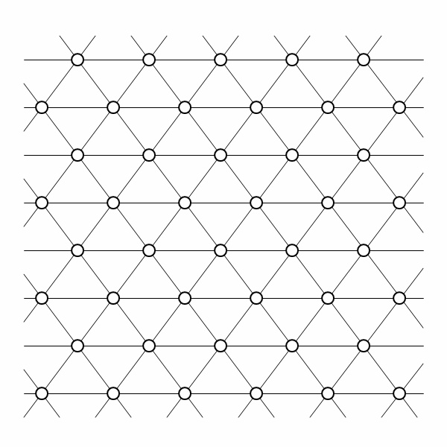
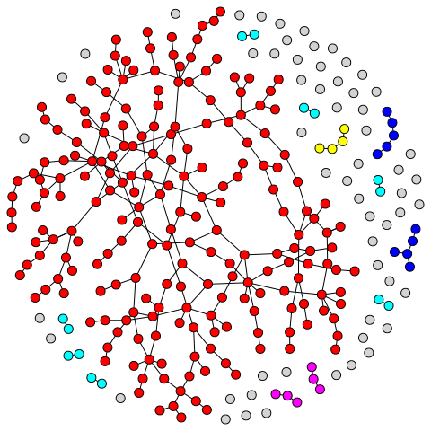
Theoretical understanding of networks
Behavior of theoretical networks typically examined in the limit N→∞
Regular lattice or grid (Physics)
  average path length ~ N^{1/D} (no. of nodes)
  clustering high
  delta function distribution of degree (links/node)
Random networks (Graph theory)
  Also known as Erdös-Renyi networks
  average path length ~ log N
  clustering low
  Poisson distribution of degree
D: spatial dimension

Slide 3

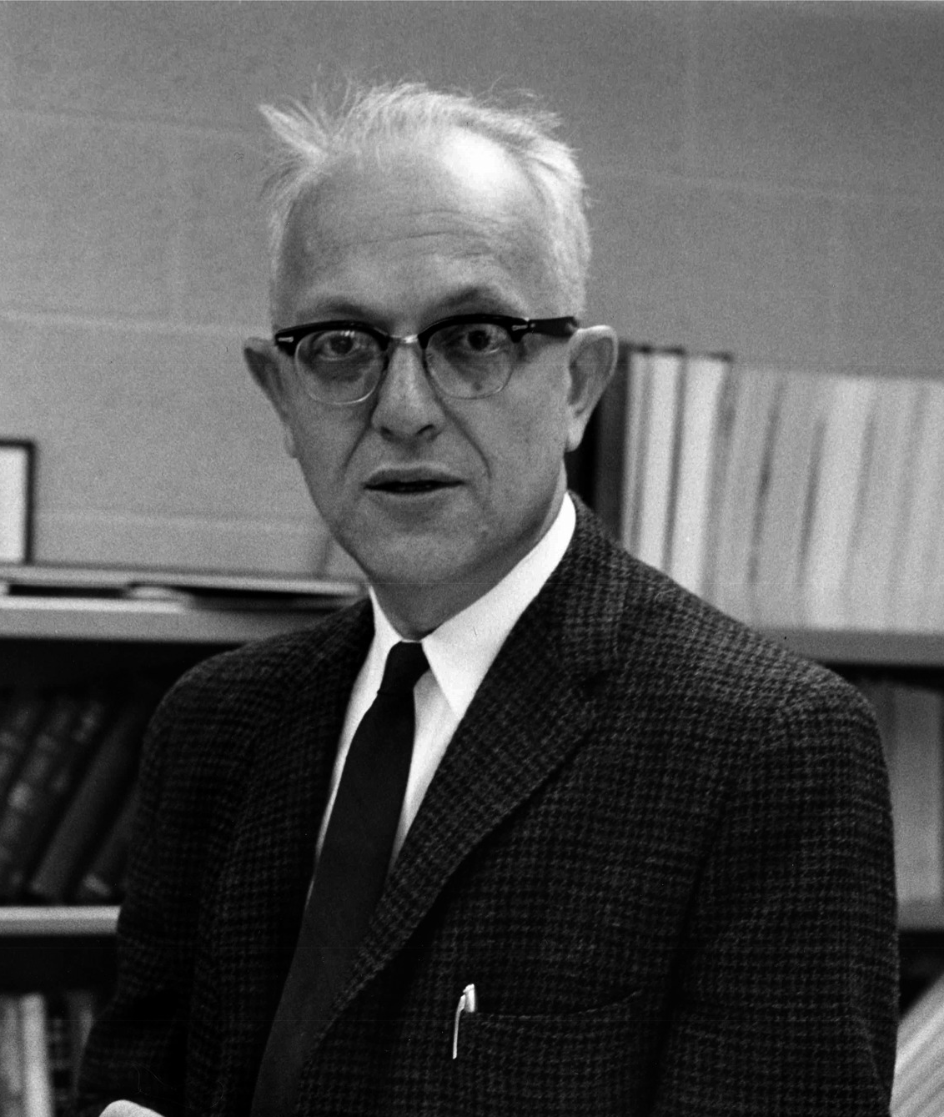

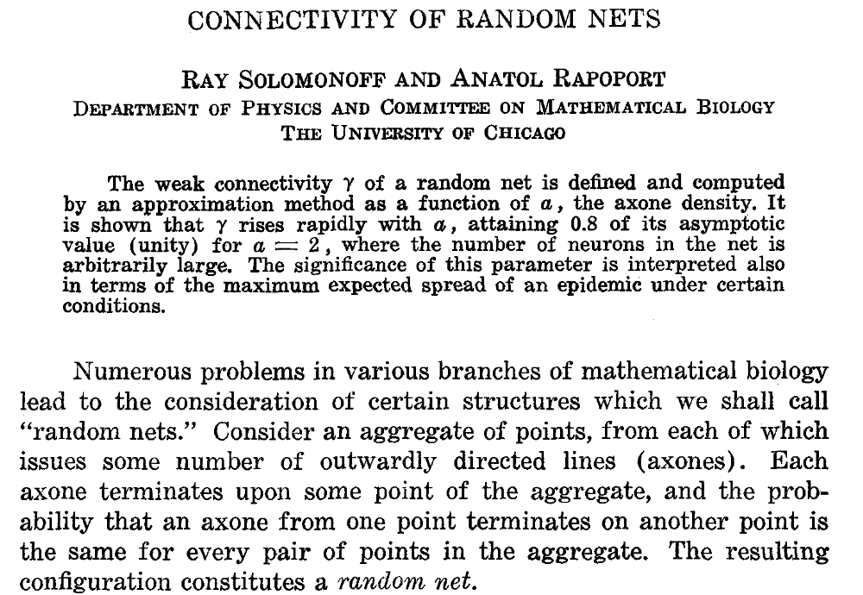
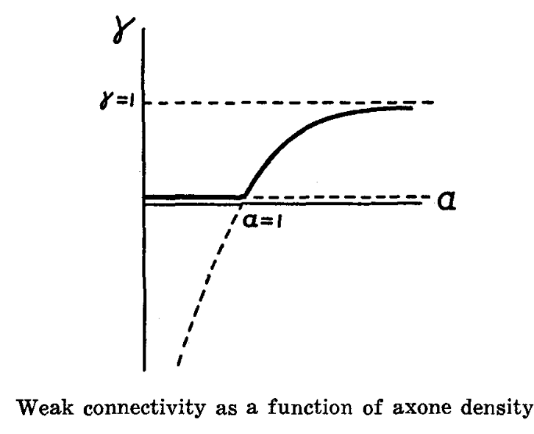
Random networks
Networks constructed by choosing to place links between each possible pair of nodes using independent, identical probability
Ray Solomonoff
Anatol Rapoport

Slide 4

Random networks
Erdös-Renyi model (1959): Two closely related probability-based models for generating random networks
Paul Erdös
Alfred Renyi
The G(N,L) model: when any member of a family of all graphs with N nodes and L links is chosen uniformly at random.
Example:
G(3,2) comprises 3 possible networks of 3 nodes A,B and C
Graph 1
A
Graph2
A
Graph 3
A
B
C
B
C
B
C
Each graph can be picked with probability 1/3

Slide 5

Random networks
Erdös-Renyi model (1959): Two closely related probability-based models for generating random networks
Paul Erdös
Alfred Renyi
s
The G(N,p) model: when a network is constructed by randomly placing a link between each possible pair of nodes with a probability p (0<p<1)
Example:
G(3, ½ ) is ensemble of all possible networks of 3 nodes A,B and C such that each link {AB, BC, AC} occurs with probability ½
A
B
C
As N→∞, p ≥ 2ln(N)/N ⇒ network will almost surely be connected

Slide 6
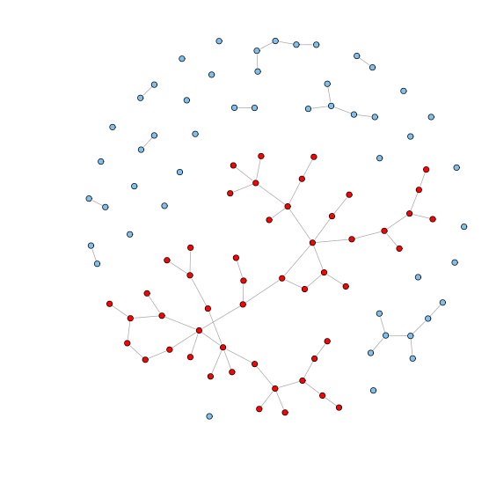
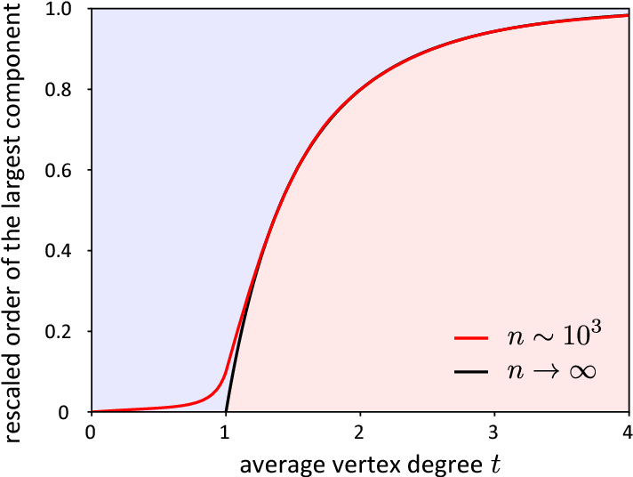
Largest Connected Component
Image: www.sci.unich.it
A largest connected component (LCC, or giant component) is a connected component whose size N_{l} is a finite fraction of that of the size N of the entire network, even as the network becomes larger and larger, i.e., Lim_{N→∞} N_{l} / N = c > 0.
In G(N,p) random network model, LCC size is
N_{l} =1 when p = 0 (isolated nodes)
N_{l} =N when p =1 (clique)
Phase transition
As p gradually increased from 0 to 1, the fraction N_{l} / N suddenly increases from 0 to a finite value (>0)
Connected
Fragmented
i.e., becomes extensive, increasing with N
at a critical value of p, p_{c} = 1/N
Image: Kang & Petrasek, Internat. Math. Nachrichten (2014)

Slide 7
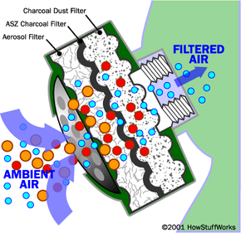
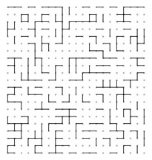
Random networks & Percolation
Random Network phase transition related to bond percolation
Percolation theory has origins in understanding the process of transport through porous medium, e.g., of toxic chemical molecules through the filtering agent of a gas mask
Consider a 2-dimensional lattice of N × N sites in which the links between any two neighboring sites is open with probability p [⇒ closed with probability (1 – p) ]
The Question:
What is the probability that a connected path exists from one side of the lattice to the other ?
Image: http://www.suffos.bam.de

Slide 8
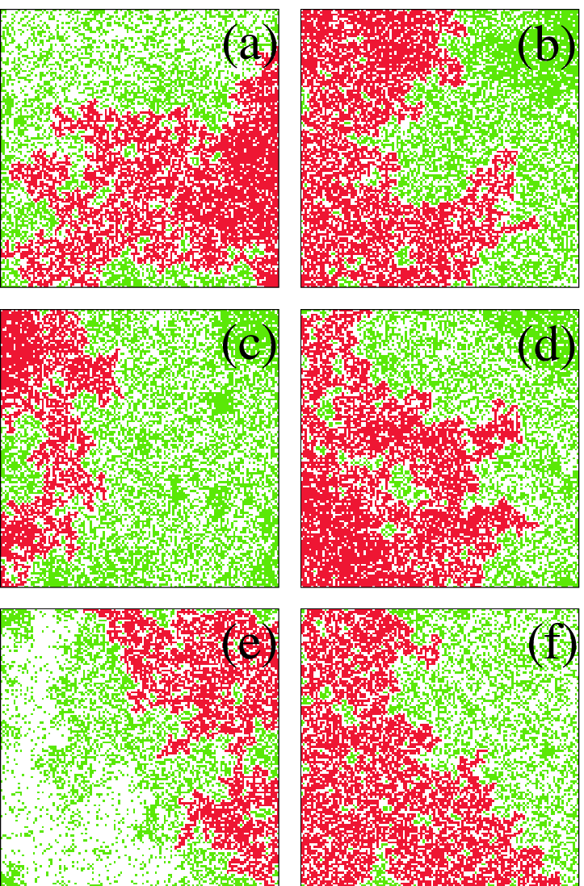
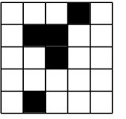
Forest Fire model
Unburnt trees
related to site percolation
Burnt trees
Image: www1.coe.neu.edu/~emelas
Each site is populated probabiility p (otherwise closed with probability 1-p).
The Question:
Is there a connected set of neighboring sites (cluster) that are occupied ?
Propagation of fire though a forest modeled as a lattice whose sites can be vacant or occupied by a tree
Once a tree is burning, fire will spread to a neighboring tree with probability p
Image: Newman & Turcotte (2002) doi: 10.5194/npg-9-453-2002

Slide 9
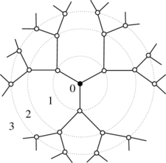
Path length & Clustering in Random networks
The average path length in the random network is ⟨ L ⟩ ∼ log ⟨N⟩ / log ⟨k⟩
Intuition:
Locally, a random network G(N,p) with very small p – as cycles or closed loops involving only a few nodes are unlikely – will be approximately like a tree
The average number of neighbors located at distance d away from a node is :
N_{d} = ⟨k⟩^{d}
N = ⟨k⟩ + ⟨k⟩² + ⟨k⟩³ + … + ⟨k⟩^{d} ∼ ⟨k⟩^{d}
Image: http://i.stack.imgur.com
Bethe Lattice

Slide 10
Path length & Clustering in Random networks
The average path length in the random network is ⟨ L ⟩ ∼ log ⟨N⟩ / log ⟨k⟩
Intuition:
Locally, a random network G(N,p) with very small p – as cycles or closed loops involving only a few nodes are unlikely – will be approximately like a tree
The average number of neighbors located at distance d away from a node is :
N_{d} = ⟨k⟩^{d}
N = ⟨k⟩ + ⟨k⟩² + ⟨k⟩³ + … + ⟨k⟩^{d} ∼ ⟨k⟩^{d}
Image: http://i.stack.imgur.com
The average clustering coefficient in a G(N,p) random network is approximately ⟨C⟩ ∼ p ≈ ⟨k⟩ / N
This is because if you randomly select a node i and look at two neighboring nodes j and k connected to it, the probability that j & k will be connected is just p

Slide 11
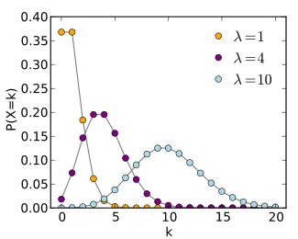
Degree distribution of Random networks
The G(N,p) model:
A given node in the network is connected with independent probability p to each of the N – 1 other nodes.
Thus the probability of being connected to k (and only k) other nodes is
p^{k}(1 – p)^{N – 1 – k}
There are ^{N – 1}C_{k} ways to choose those k other vertices, and hence the total probability of being connected to exactly k others is
p_{k} = ^{N – 1}C_{k} p^{k}(1 – p)^{N – 1 – k}
which is the Binomial distribution having mean Np and variance Np(1 – p)
As N becomes large with p being extremely small (→0), such that Np = ⟨k⟩ = λ is finite, this tends to the Poisson distribution
P(k) = e^{-λ} (λ^{k}/k!)
Both the mean and variance is given by λ.
For large values of λ this converges to the bell-shaped Gaussian or Normal distribution
Source: wikipedia

Slide 12
Theoretical understanding of networks
Regular lattice or grid (Physics)
  average path length ~ N (no. of nodes)
  clustering high
  delta function distribution of degree (links/node)
Random networks (Graph theory)
  Also known as Erdos-Renyi networks
  average path length ~ log N
  clustering low
  Poisson distribution of degree
Empirical networks are not random – many have certain structural patterns

Slide 13
Macro-patterns

Slide 14

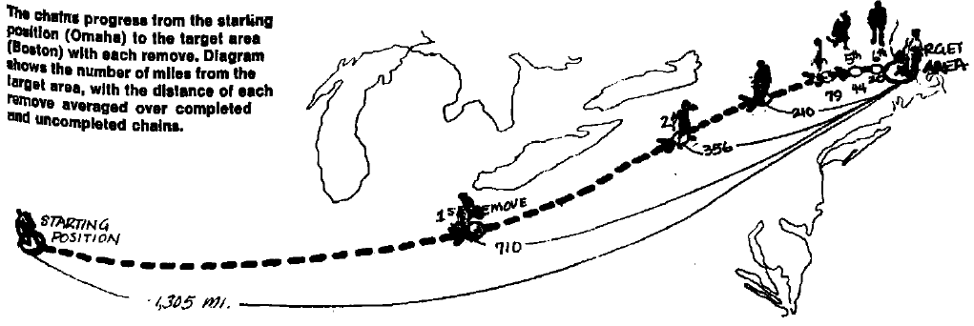
“It’s a small world”: The Milgram Experiment
Stanley Milgram (1933-1984), US social psychologist
Arbitrarily selected individuals in Nebraska were asked to generate acquaintance chains (knowing on first name basis) connecting them to a target individual in Boston
In one experiment, 64 of the 296 chains initiated eventually reached the target – the mean number of intermediaries between source and target being slightly larger than 5
⇒ Six degrees of separation
eweb.furman.edu
Milgram, 1967

Slide 15






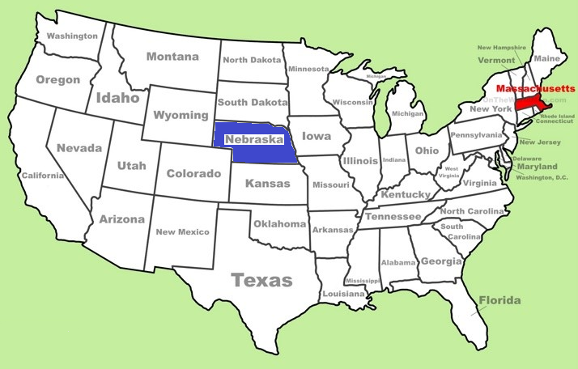

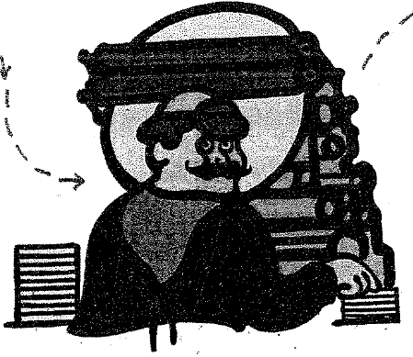
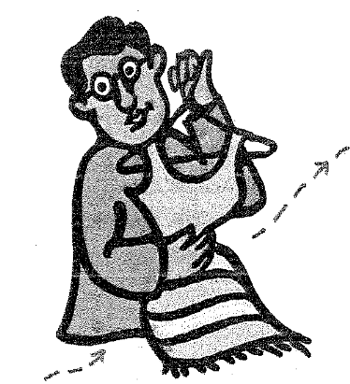
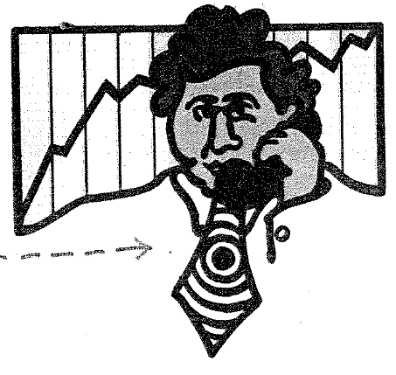
Clerk in Omaha
Self-employed friend in Council Bluffs, Iowa
Tanner in Sharon,Mass.
Publisher in Belmont,Mass.
Source
Sheet metal worker in Sharon,Mass.
Dentist in Sharon,Mass.
Stock broker in Sharon,Mass.
Printer in Sharon,Mass.
Cloth merchant in Sharon,Mass.
Across the country in eight hops
Target

Slide 16
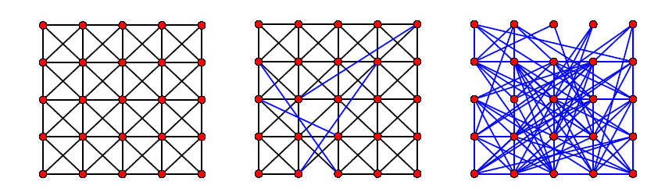
“Small world” networks
High clustering,
Large path length
High clustering,
Short path length
Low clustering,
Short path length
Regular Network
“Small-world” Network
Random Network
p = 0
0 < p < 1
p = 1
Increasing Randomness
p: fraction of random, long-range connections
Watts and Strogatz (1998): Many biological, technological and social networks have connection topologies that lie between the two extremes of completely regular and completely random.

Slide 17
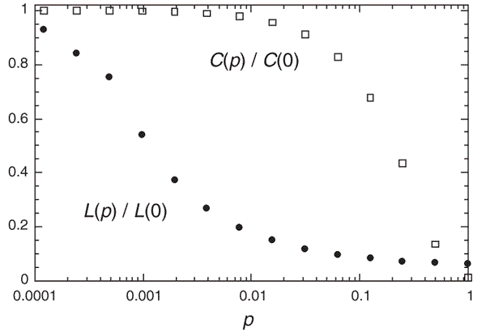

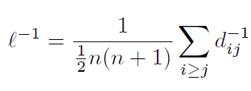



“Small world”: Local properties of regular networks but global properties of random networks
Characteristic path length
L
: shortest distance between nodes i and j
Alternatively
Clustering coefficient
where
Watts & Strogatz, 1998
Alternatively
Small-world networks can be highly clustered (like regular networks ),
yet have small characteristic path lengths (as in random networks ).

Slide 18
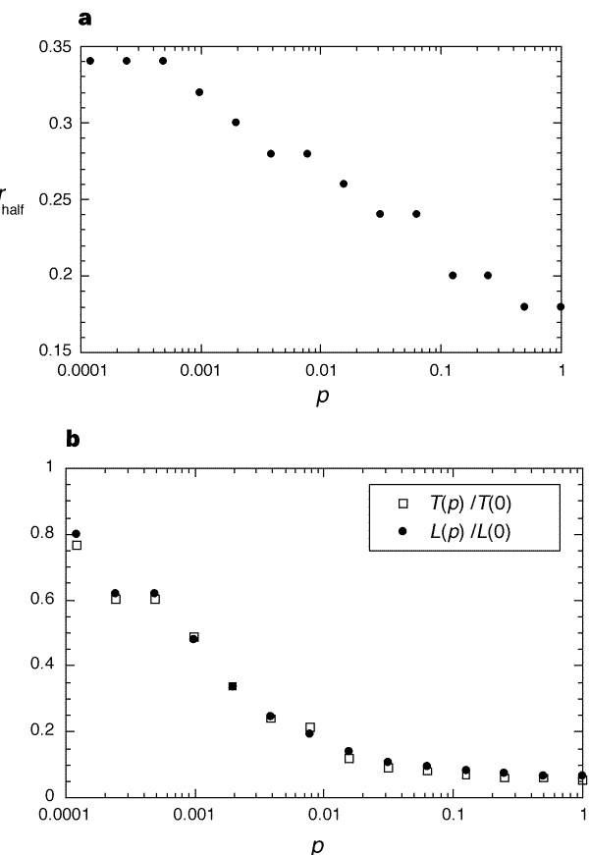
Epidemics on “Small world”
Watts & Strogatz, 1998
Dynamical process:
Time t = 0: single infected individual present.
Each infected agent can infect any of its neighbours with probability r.
Infected individuals removed (by immunity or death) after unit period of sickness.
Key Results:
Critical infectiousness r_{half}, at which the disease infects half the population, decreases with p
Time required for a maximally infectious disease (r = 1) to spread throughout the entire population T(p) has same form as characteristic path length L(p)
⇒ rewiring only a few links in the original lattice causes global infection to occur almost as fast as in random network
Implication:
“Control the truck-drivers”

Slide 19
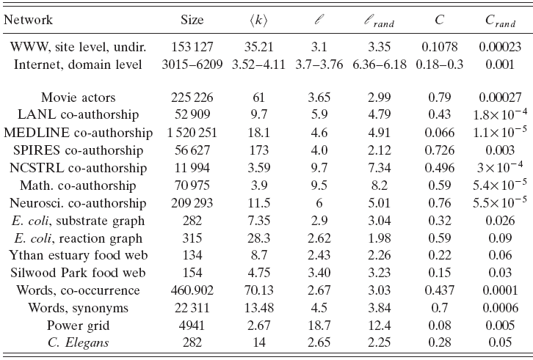
Do small-world networks occur in real life ?
# nodes
Avg degree
Avg path length
Clustering coefficient
Albert & Barabasi, 2003

